Slide 1

Telecom Customer Churn Analysis
Nick (JinShuo) Chen
Data Science Capstone Project,
January 1st, 2022

Slide 2
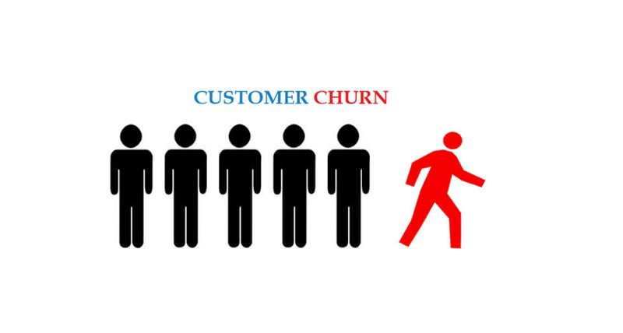
Problem Statement
Currently, high customer churn rate has been leaded to a direct loss of returning revenue
Stakeholders want this problem solve immediately
To retain customers, our marketing team needs to know who are the customers will churn?

Slide 3
The Data Science Approach
Data acquisition and wrangling: collect all possible customer information/data in our company’s databases. And clean it for easy access and analysis
Exploratory data analysis: discover patterns between each feature in the data and the customer churn
Modeling: Build models to predict who are customers will churn

Slide 4
Results
Built 4 models, logistic Regression, K-Nearest, Random Forest Classifier and XGBoost.
Random Forest Classifier is best model has accuracy rate 88.74% and false negative rate only 5.77%
False negative rate is the chance the model predicted the customer will not churn, but they do churn which we want as lower as possible
Discovered useful patterns for marketing team, will explain more detail in data exploratory section

Slide 5
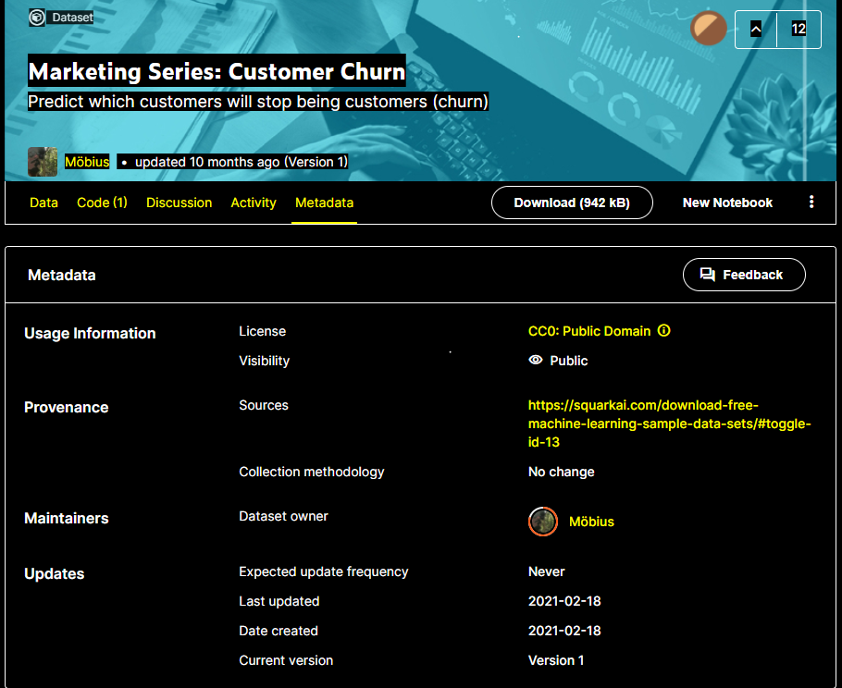
Data information
“Marketing Series: Customer Churn” dataset from Kaggle.com which is sourced from squarkai.com (Yes, our company store customer information in Squark AI’s database)
Contains 6499 rows (each representing a unique customer) with 21 columns: 19 features, 1 target feature (Churn).
Stored in CSV file

Slide 6
Data columns (total 21 columns):
# Column Non-Null Count Dtype
--- ------ -------------- -----
0 CustomerID 6499 non-null object
1 Gender 6499 non-null int64
2 Senior Citizen 6499 non-null int64
3 Partner 6499 non-null object
4 Dependents 6499 non-null object
5 Tenure 6499 non-null int64
6 Phone Service 6499 non-null object
7 Multiple Lines 6499 non-null object
8 Internet Service 6499 non-null object
9 Online Security 6499 non-null object
10 Online Backup 6499 non-null object
11 Device Protection 6499 non-null object
12 Tech Support 6499 non-null object
13 Streaming TV 6499 non-null object
14 Streaming Movies 6499 non-null object
15 Contract 6499 non-null object
16 Paperless Billing 6499 non-null object
17 Payment Method 6499 non-null object
18 Monthly Charges 6499 non-null float64
19 Total Charges 6490 non-null float64
20 Churn 6499 non-null object
Notes:
The data look clear, only the Total Charge column has 9 null values.
Since it is very little compare the whole dataset. I drop the 9 rows with null values using dropna().

Slide 7
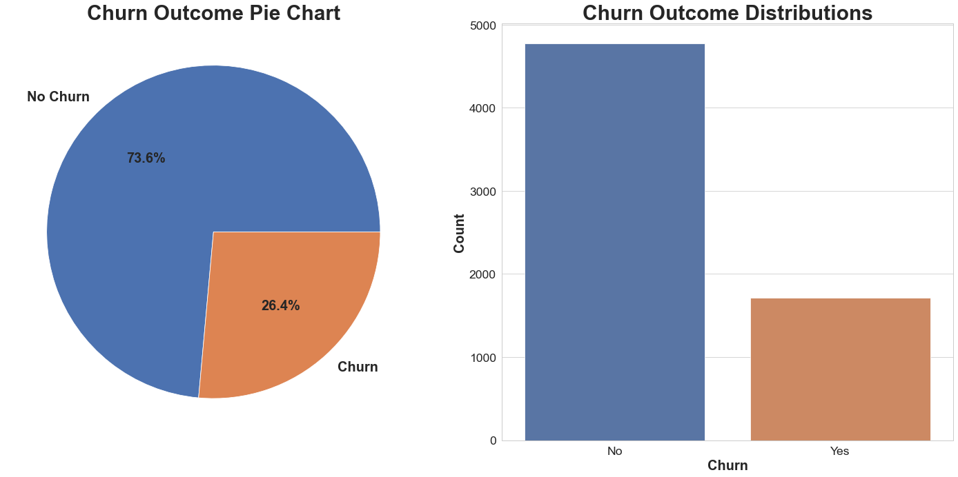
Exploratory analysis – Target Feature (Churn)

Slide 8
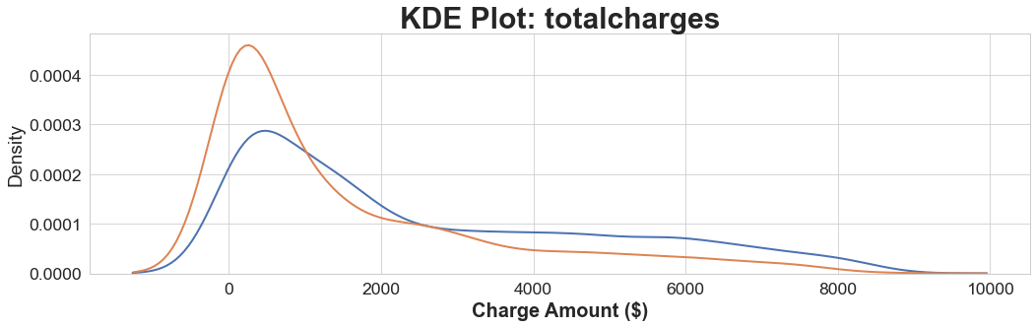
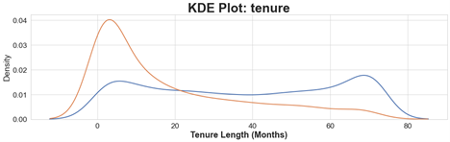
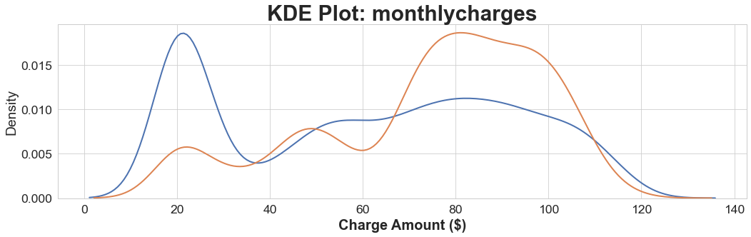
Numerical Features
Notes:
Tenure: Customers who churn have the highest probability of occurring before 20 months of tenure
Monthly Charges: Generally speaking, Likelihood of a customer churning increases as charges increase, and customers have the highest probability of churning when their monthly charges exceed 60 dollars. Customers who do not churn are most likely to have bills around 20 dollars, followed by just over 80 dollars.
Total Charges: Distributions mostly too general for impact of feature (Monthly is most likely more important)

Slide 9
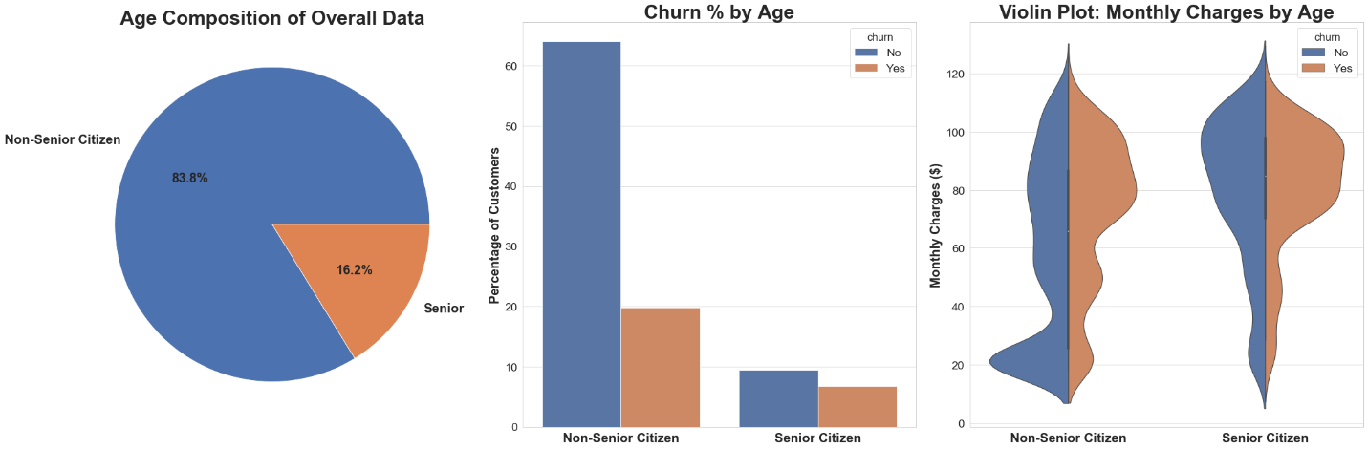
Age
Notes:
Our dataset has significantly fewer senior citizens than non-senior citizens
Overall, more non-senior citizens will churn than senior citizen
A higher proportion of senior citizens will churn than non-senior citizens
Senior citizens and non-senior citizens both begin to churn once the monthly charges rise above $60
Non-senior citizens are most likely to have monthly charges around 20 dollars
Non-senior citizens will churn are slightly more likely to churn at monthly charges lower than $60 than senior-citizens

Slide 10
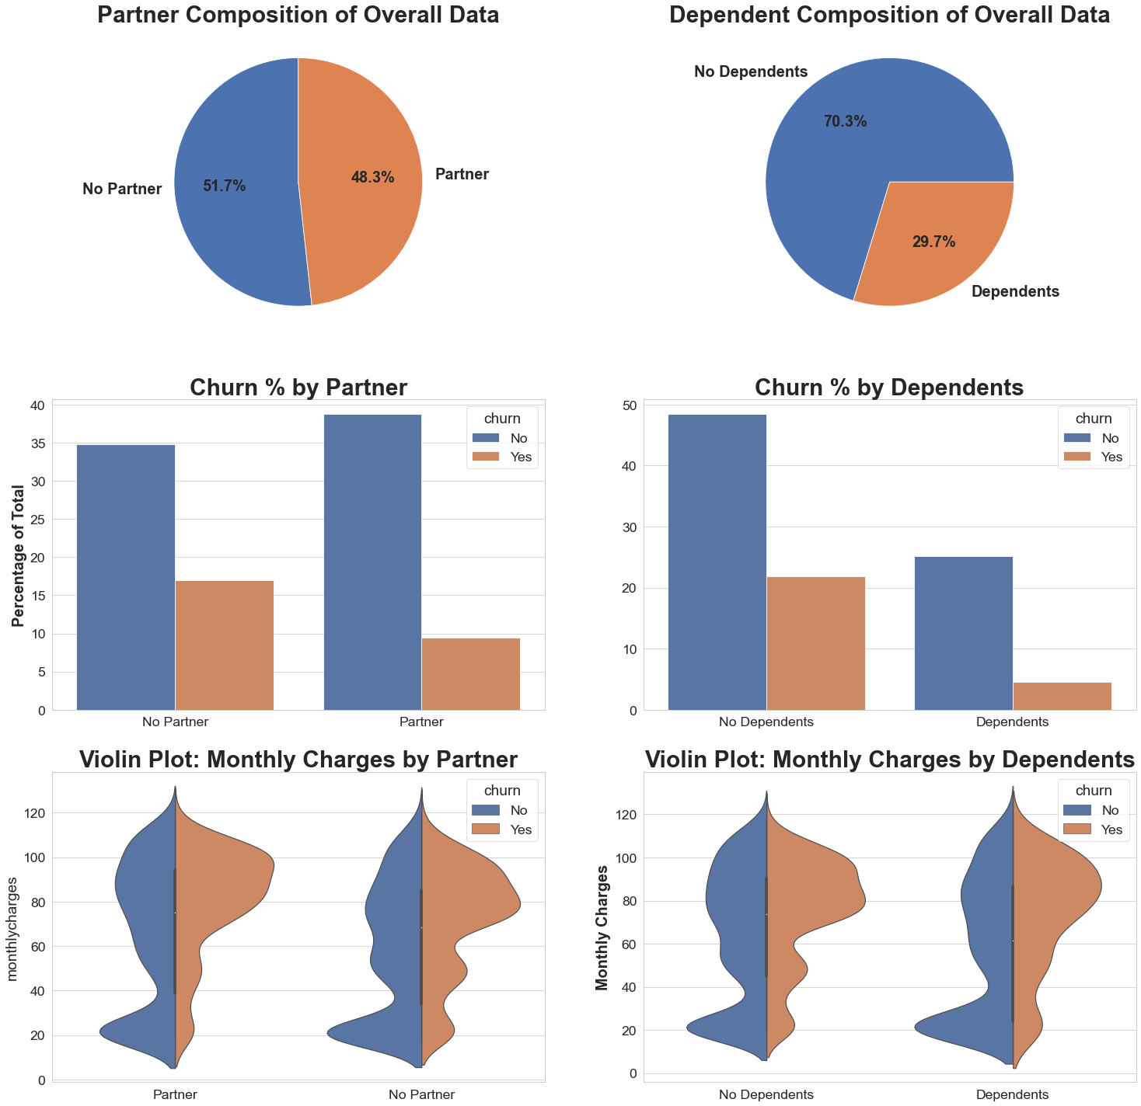
Partner & Dependents
Notes:
Overall, those without partners are more likely to churn than those with partners
Customers without dependents are more likely to churn than those with dependents
Monthly charges among those who churn and don’t churn are pretty similar for both partner values and both dependent values

Slide 11
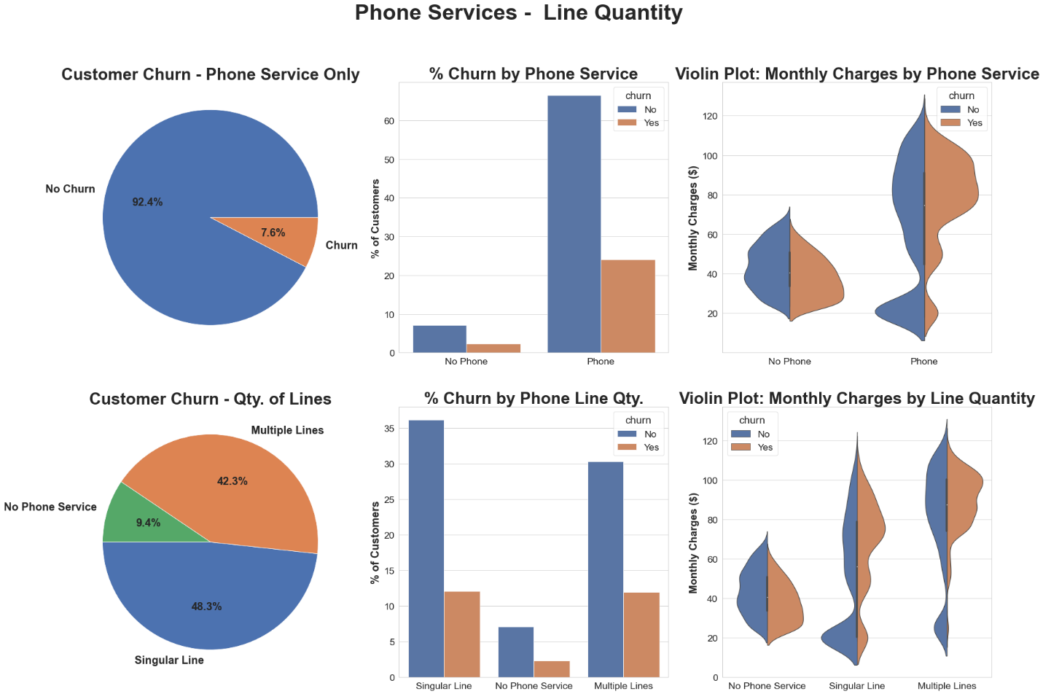
Phone Service & Quantity of Lines
Notes:
Significantly more customers with only phone service will not churn than those other customers
People with only phone service churn about 25% of the time
Customers with phone services only pay a higher average monthly charge
Customers with multiple lines churn at approximately the same rate as those with a singular line
Customers with multiple lines more frequently pay a higher monthly charge than those with singular phone lines

Slide 12
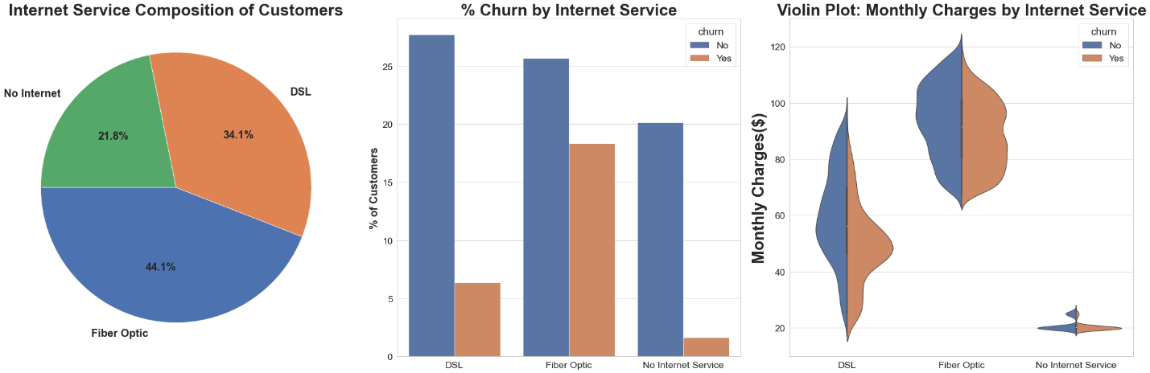
Internet Service
Notes:
Fiber Optic is the most popular internet option
Fiber optic Internet Customers churn at significantly proportions than DSL or No Internet customers
Fiber Optic is a significantly more expensive service, and customers churn slightly more than not when they have this service
Customer with DSL are most likely to churn when their monthly charges are between $40 and $60.

Slide 13
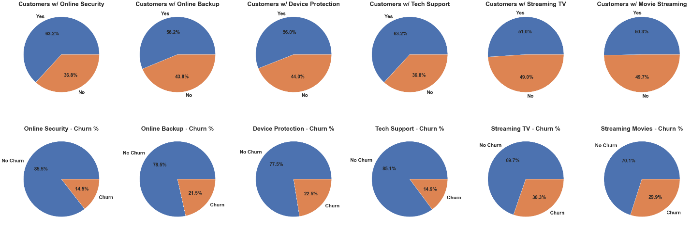
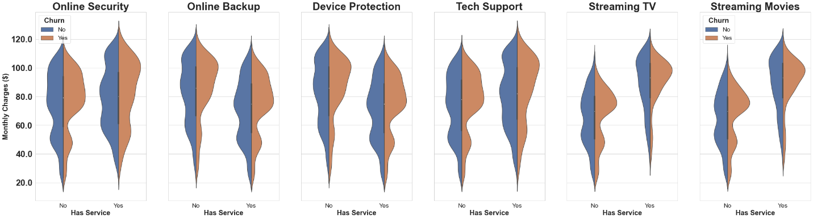
Add-on Serivces
Notes:
Customers with TV streaming and/or Movie Streaming services churn more than all other add-on services
Churn for customer in most categories will peak around a monthly charge of $100
Contracts
More than half of customers use a monthly payment option
Significantly more customers churn on monthly plans
The longer the plan, the lower the churn rate
Monthly charges are generally higher the longer the contract is

Slide 14
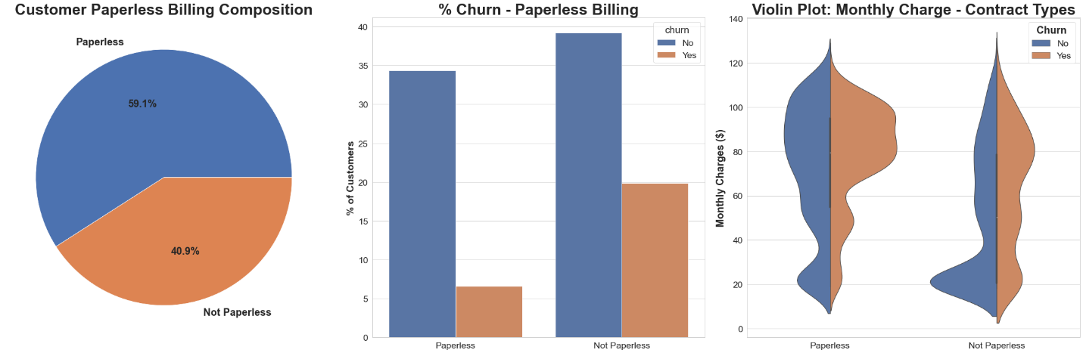
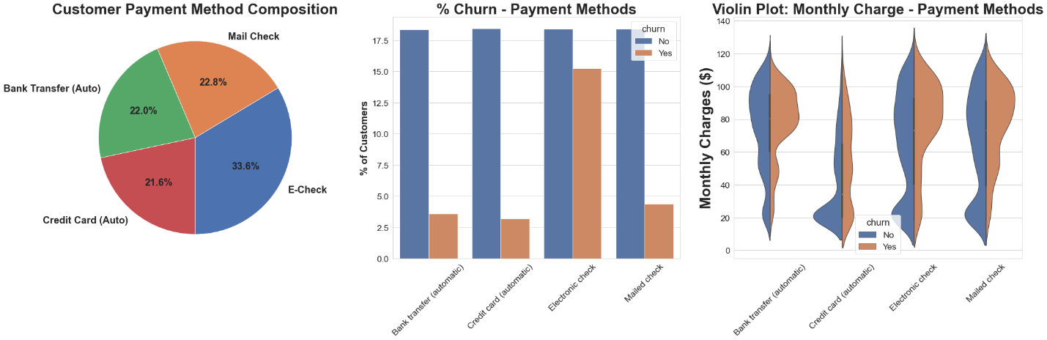
Paperless Billing & Payments
Notes:
Customers with non-paperless billing churn almost 15% more than paperless customers
Paperless customers churn at similar rates as non-paperless customers when the monthly price is below 60 dollars, once above 60 more paperless customers churn than non-paperless
Customers who pay with e-check churn more than 10% customers with all other payments methods
Customers who pay by credit have consistent churn rates regardless of monthly charge, whereas customers paying by bank transfer, e-check, or mailed check all see an up tick in churn once monthly charges rise above 60.

Slide 15
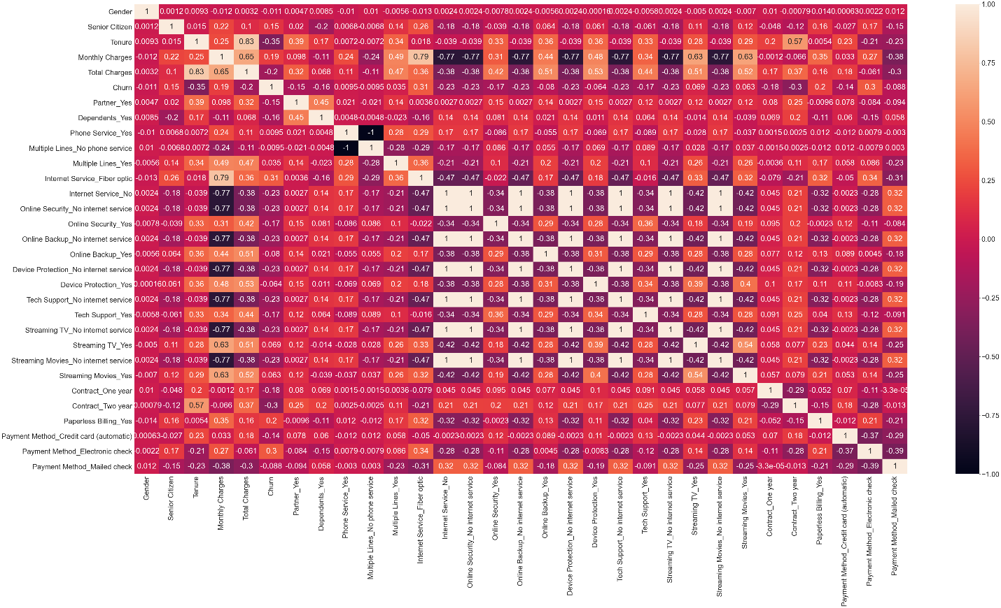
Notes:
there is no signal features has very strong correlation with customer churn. The features that have the highest correlation are Tenure, -0.35, internet service fiber optic .31 and payment method, 0.3.

Slide 16
Data Preprocessing
Create dummy variables for object features
Split data into target feature and predicting features
Feature Scaling
Random over-sampling
Train – Test – Split

Slide 17
Baseline Modeling
Results with default hyperparameters
Model | Accuracy | False Negative Rate | AUC
Logistic Regression | 76.55% | 21.45% | 0.840
K-Nearest Neighbors | 75.48% | 17.30% | 0.816
Random Forest Classifier | 88.14% | 5.95% | 0.960
XGBoost | 78.31% | 18.58% | 0.855
Results After Hyperparameters Tuning
Model | Accuracy | False Negative Rate | AUC
Logistic Regression | 76.69% | 20.74% | 0.840
K-Nearest Neighbors | 84.24% | 8.04% | 0.841
Random Forest Classifier | 88.32% | 5.86% | 0.959
XGBoost | 89.53% | 6.17% | 0.960

Slide 18
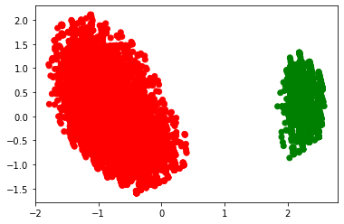
Extended Modeling
Applied unsupervised clustering to do customer segmentation
Add the results back the data as a feature to predict customer churn
Used Elbow method and Silhouette Analysis to determine how many clusters
Used n_clusters = 2

Slide 19
Extended Modeling
Baseline Modeling
Model | Accuracy | False Negative Rate | AUC
Logistic Regression | 76.69% | 20.74% | 0.840
K-Nearest Neighbors | 84.24% | 8.04% | 0.841
Random Forest Classifier | 88.32% | 5.86% | 0.959
XGBoost | 89.53% | 6.17% | 0.960
Extended Modeling
Model | Accuracy | False Negative Rate | AUC
Logistic Regression | 76.69% | 20.74% | 0.840
K-Nearest Neighbors | 84.24% | 8.04% | 0.841
Random Forest Classifier | 88.74% | 5.77% | 0.960
XGBoost | 89.48% | 6.27% | 0.960
Notes:
Logistic Regression and KNN did not charge
RFC everything increase
XGBoost got a little worse

Slide 20
Recommendation and Future work
Recommend use Random Forest Classifier to predict customer churn
Pay attention to customer who are non-sensor, without dependents has Fiber Optic service and payment method is electronic check. They have the highest chance to churn
For future work, I would like to collect more information from the customers
Add question to website to ask the churn customer the reason they leave

